Slide 1

Programming and Data Visualization for Researchers
[HEL-8048 /
PSY-3035]
Workshop 3
James McCutcheon
IPS / Helsefak

Slide 2
Introduction to data visualisation
The content of this short lecture is based extensively on Fundamentals of Data Visualization by Claus O Wilke, which is freely available online
  https://clauswilke.com/dataviz/
I strongly recommend that everybody takes the time to read through the whole book. It is well-written, beautifully presented and not too long.

Slide 3
Important foundations
Data visualization is part art and part science
  The challenge is to get the art right without getting the science wrong!
A data visualization has to accurately convey the data without misleading or distorting
  If one number is twice as big as another then it should look twice as big
Good data visualizations should enhance the message, not distract from it

Slide 4
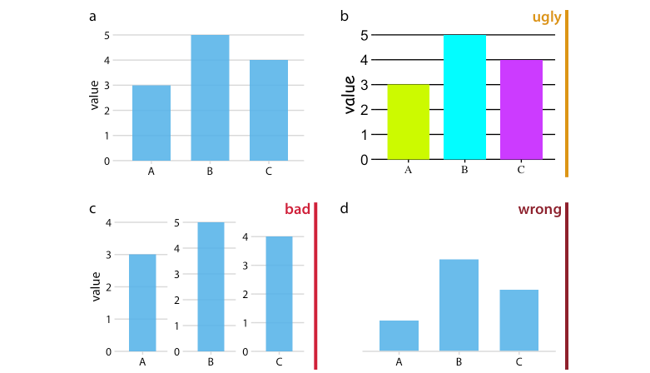
Ugly, bad and wrong figures
Ugly - A figure that has aesthetic problems but otherwise is clear and informative.
Bad - A figure that has problems related to perception; it may be unclear, confusing, overly complicated, or deceiving.
Wrong - A figure that has problems related to mathematics; it is objectively incorrect.

Slide 5
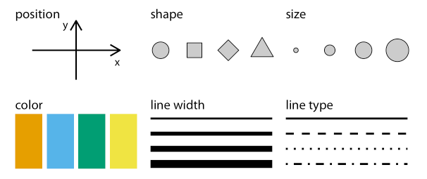
Aesthetics and data types
The data that we want to represent can come in different types, e.g. continuous, discrete, categorical etc…
Different aesthetics can be used to represent different data types
Which of these aesthetics can be used to represent continuous data?

Slide 6
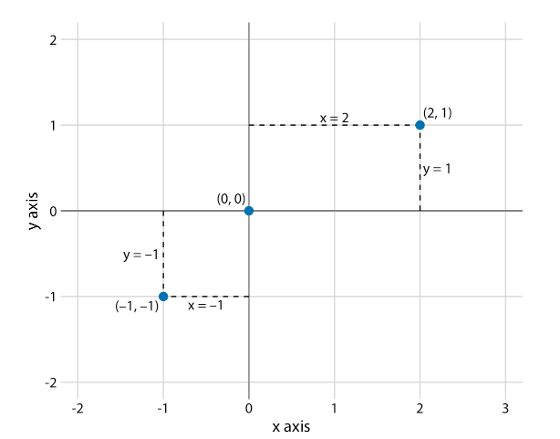
Coordinate systems and axes
Position scales are critical for any data visualization as they determine where different data will be located
For example, in a 2d figure we use two numbers to specify a point and so two scales are needed
  Usually an x and y axis, arranged horizontally and vertically, although does not have to be
Standard 2d Cartesian coordinate system

Slide 7
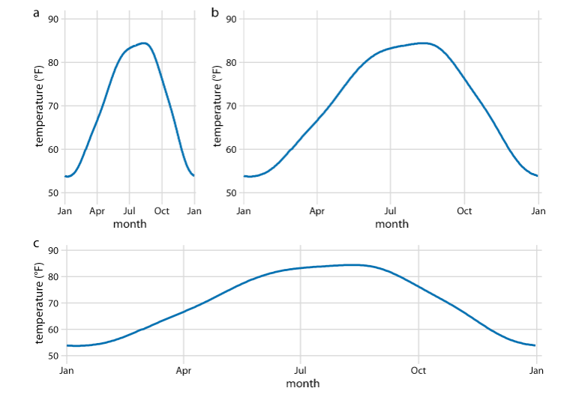
Coordinate systems and axes
If different units are on each axis then you are free to change the size to make sure important differences are noticeable
Daily temperature in Houston

Slide 8
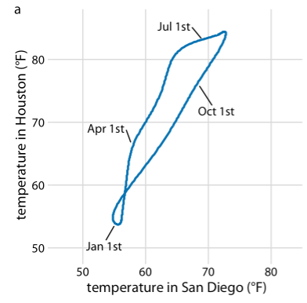
Coordinate systems and axes
If different units are on each axis then you are free to change the size to make sure important differences are noticeable
If same units are on both axes then the spacings must be equal or it would distort the data
Daily temperature in Houston vs. daily temperature in San Diego

Slide 9
Non-linear axes
So far we have looked at linear axes where data are evenly-spaced along the axis
On non-linear axes, data is not evenly spaced along the axis
This can help to compress the data so that very large and/or very small numbers can be accurately visualized in the same figure

Slide 10
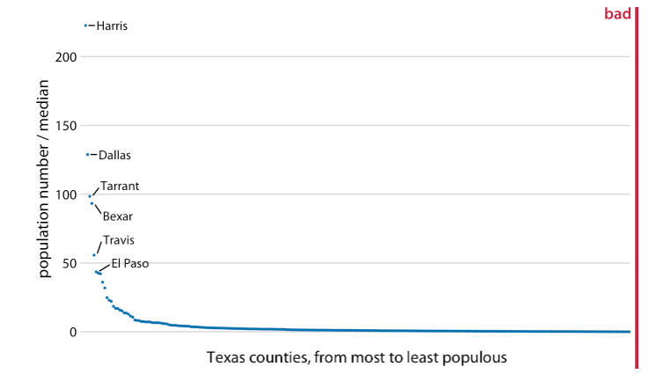
Very difficult to see most of the data in this figure

Slide 11
Non-linear axes
Logarithmic (log) axes are the most common non-linear axis
Fo example, log₁₀ (spoken as log base 10) converts data as…
Exponents
  10³ = 1000
  10² = 100
  10¹ = 10
  10⁰ = 1
  10⁻¹ = 0.1
  10⁻² = 0.01
  10⁻³ = 0.001
3
2
1
0
-1
-2
-3
Using a log scale we can now show very big and very small numbers in the same figure

Slide 12
Non-linear axes
  10³ = 1000
  10² = 100
  10¹ = 10
  10⁰ = 1
  10⁻¹ = 0.1
  10⁻² = 0.01
  10⁻² = 0.001

Slide 13
Non-linear axes
  10³ = 1000
  10² = 100
  10¹ = 10
  10⁰ = 1
  10⁻¹ = 0.1
  10⁻² = 0.01
  10⁻² = 0.001

Slide 14
Non-linear axes
  10³ = 1000
  10² = 100
  10¹ = 10
  10⁰ = 1
  10⁻¹ = 0.1
  10⁻² = 0.01
  10⁻² = 0.001

Slide 15
Non-linear axes
  10³ = 1000
  10² = 100
  10¹ = 10
  10⁰ = 1
  10⁻¹ = 0.1
  10⁻² = 0.01
  10⁻² = 0.001

Slide 16
Non-linear axes
  10³ = 1000
  10² = 100
  10¹ = 10
  10⁰ = 1
  10⁻¹ = 0.1
  10⁻² = 0.01
  10⁻² = 0.001

Slide 17
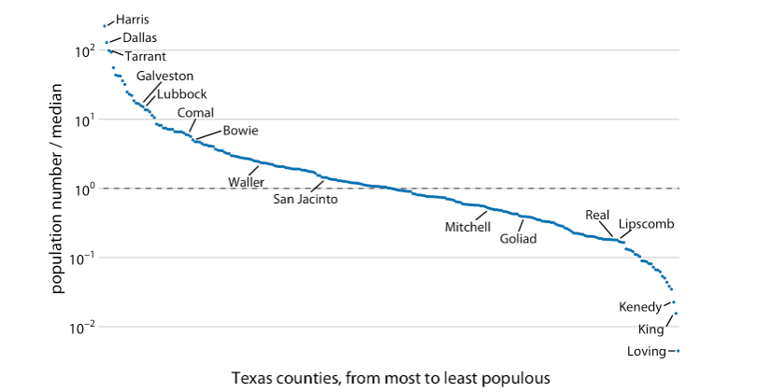
Non-linear axes
100
Here the spread of the data is more easily seen
A ratio of 1 (10⁰) means that the county has exactly the median
Non-linear scales are especially good if the data you are plotting come from multiplication or division (e.g. a ratio)
10
1
0.1
0.01

Slide 18
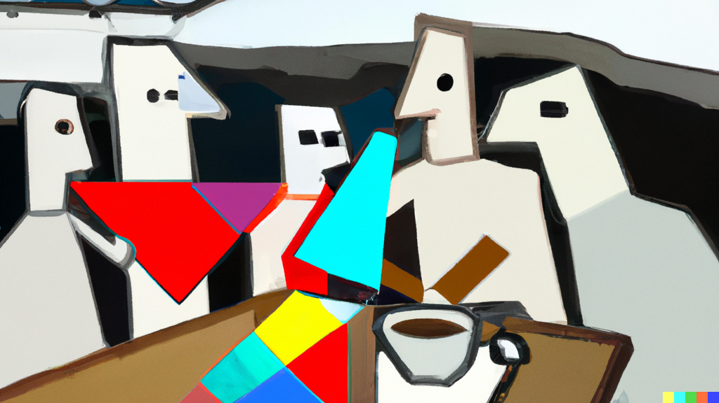
COFFEE TIME

Slide 19

Your projects (the “exam”)
Final assessment will be via submission of a homework project in which the student has analyzed their own data, tested hypotheses, and produced graphical output. The project must be submitted to an online repository with full documentation.
The grading is Bestått (approved) / Ikke bestått (not approved).
All submitted projects must have:
  Link to an online Github repository
  PDF with documentation and short write-up of project including examples of figures and justification of choices.

Slide 20
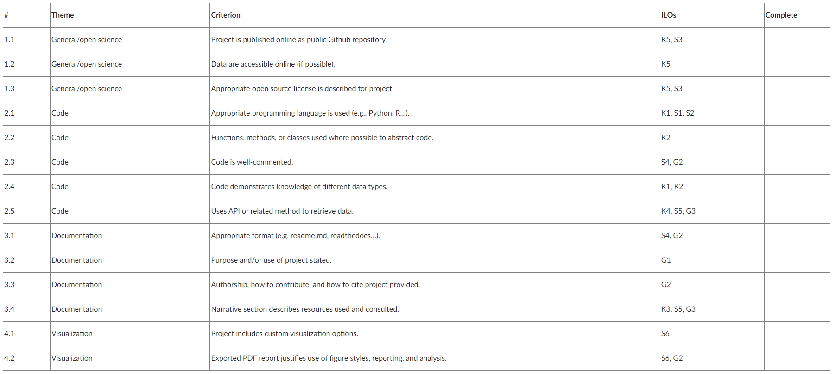
Your projects (the “exam”)

Slide 21
Color
There are three fundamental uses for color in data visualization
  To distinguish groups of data from each other
  To represent data values
  As a way of highlighting data
The types of colors that we use and how we use them are quite different for each of these cases

Slide 22
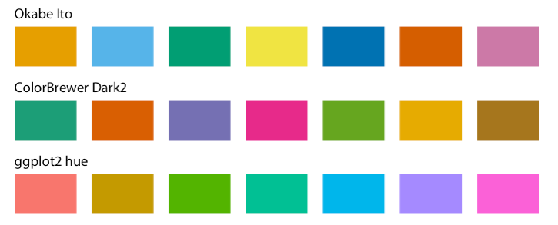
Color as a tool to distinguish
Commonly used to distinguish discrete items that do not have an intrinsic order
  Different countries on a map
Here, we use a qualitative color scale where…
  A finite set of colors look distinct but are also equivalent
  Colors should not create impression of an order
Three examples of qualitative color scales

Slide 23
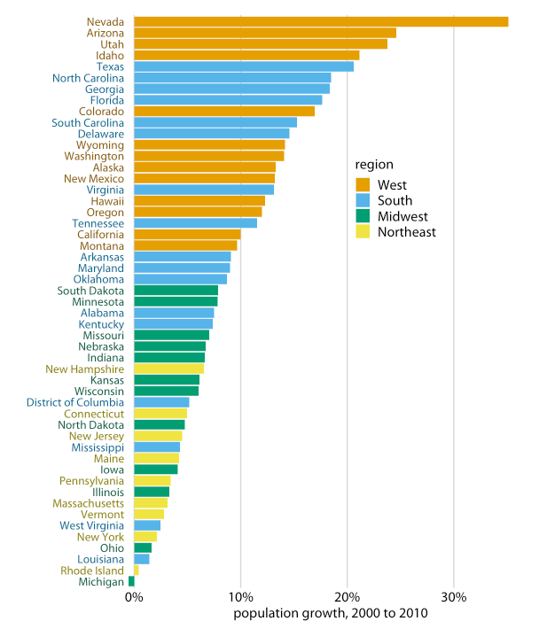
Color as a tool to distinguish
Commonly used to distinguish discrete items that do not have an intrinsic order
  Different countries on a map
Here, we use a qualitative color scale where…
  A finite set of colors look distinct but are also equivalent
  Colors should not create impression of an order

Slide 24
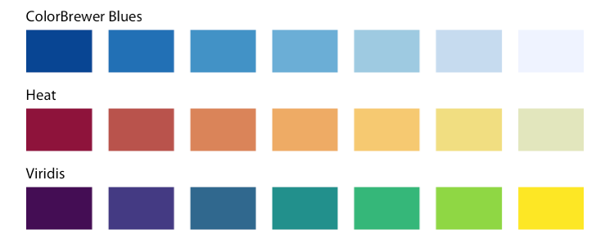
Color to represent data values
A sequential color scale can be used to represent data, e.g. income
The sequence should clearly indicate…
  Which values are larger or smaller than others
  How distant two values are from each other
Important that color scale is perceived uniformly across the entire range
Three examples of sequential color scales

Slide 25
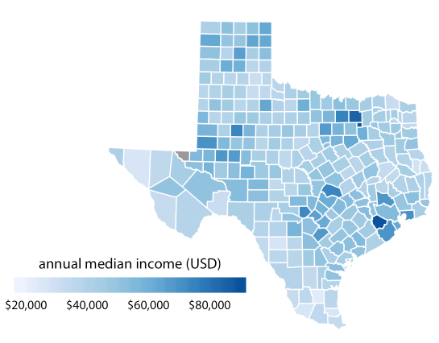
Color to represent data values
A sequential color scale can be used to represent data, e.g. income
The sequence should clearly indicate…
  Which values are larger or smaller than others
  How distant two values are from each other
Important that color scale is perceived uniformly across the entire range

Slide 26
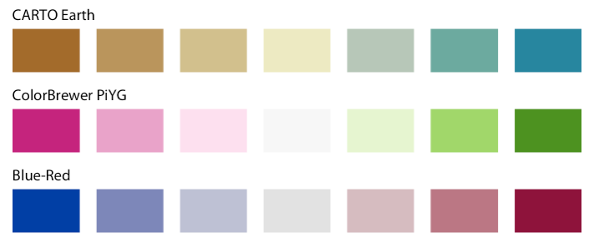
Color to represent data values
We can also use a diverging color scale to show data that a positive and negative (or diverge from a neutral midpoint)
Important that these scales are balanced so that the transition from light to dark is the same in both directions
Examples of diverging color scales

Slide 27
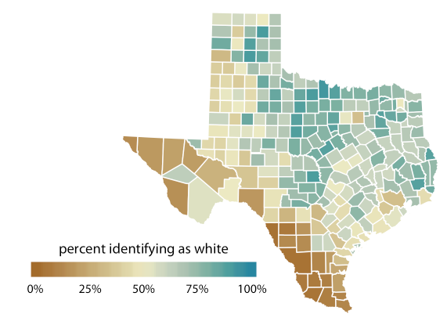
Color to represent data values
We can also use a diverging color scale to show data that a positive and negative (or diverge from a neutral midpoint)
Important that these scales are balanced so that the transition from light to dark is the same in both directions

Slide 28
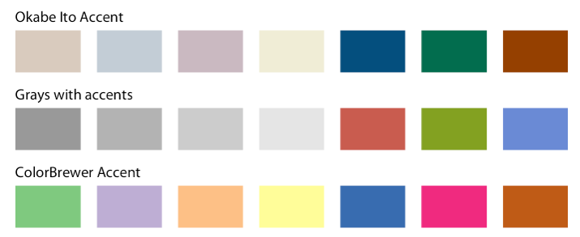
Color as a tool to highlight
Color can be an effective tool to highlight specific elements
Can use accent color scales
These contain both subdued colors and a matching set of stronger colors
Examples of accent color scales

Slide 29
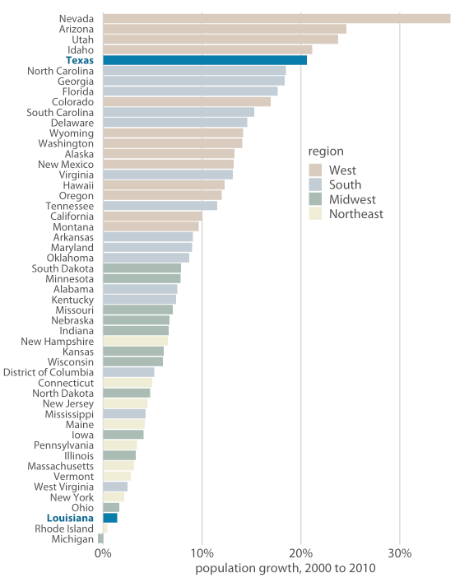
Color as a tool to highlight
Color can be an effective tool to highlight specific elements
Can use accent color scales
These contain both subdued colors and a matching set of stronger colors

Slide 30
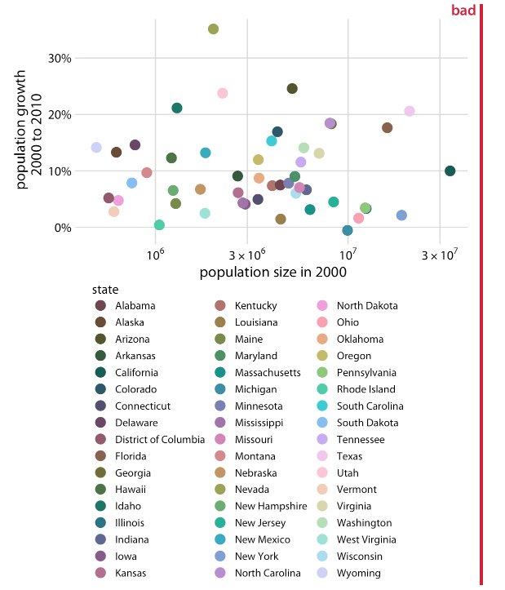
Encoding too much or irrelevant information
Don’t try to encode too many items with different colors
Qualitative colors scales work best with three to five categories
Too much work to go between the data and the legend trying to work out what each color represents

Slide 31
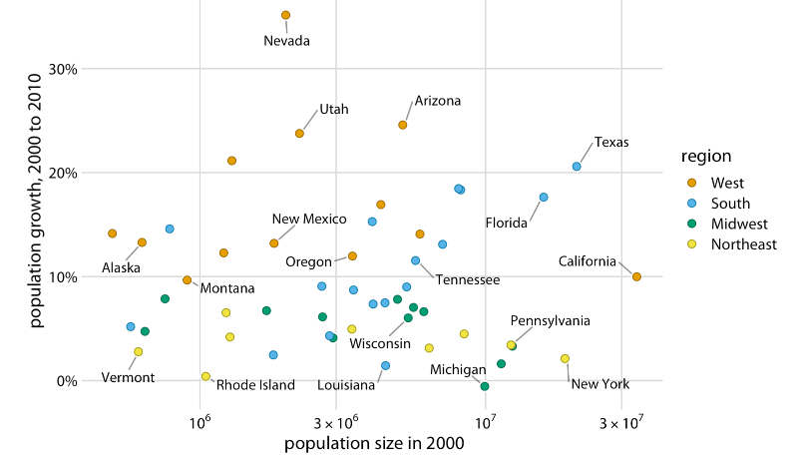
Encoding too much or irrelevant information
Don’t try to encode too many items with different colors
Qualitative colors scales work best with three to five categories
Too much work to go between the data and the legend trying to work out what each color represents

Slide 32
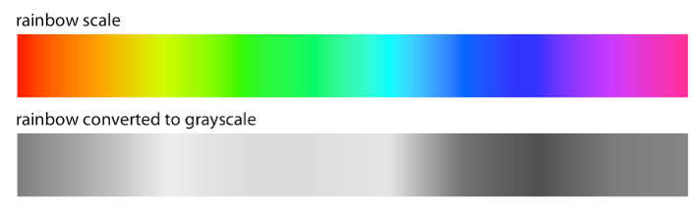
Non-monotonic color scales to encode data
Remember! Colors need to show…
  Which data values are larger or smaller than each other
  How distant values are from each other
The rainbow scale is highly non-monotonic

Slide 33
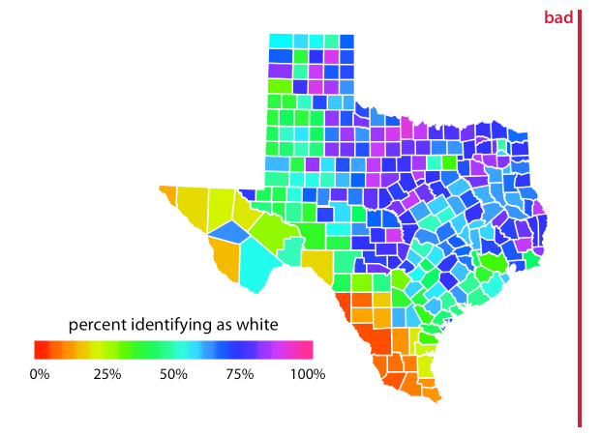
Non-monotonic color scales to encode data
Remember! Colors need to show…
  Which data values are larger or smaller than each other
  How distant values are from each other
The rainbow scale is highly non-monotonic

Slide 34
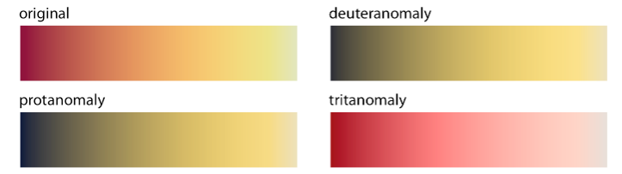
Not designing for color deficiency
Many of our readers may have some form of color-vision deficiency (CVD) – i.e. be “color-blind”
  Protanomoly – difficulty with red
  Deuteranomoly –difficulty with green
  Tritanomly – difficulty with blue
Approx 8% males, 0.5% females
Safe to use as in all cases we see a clear gradient

Slide 35
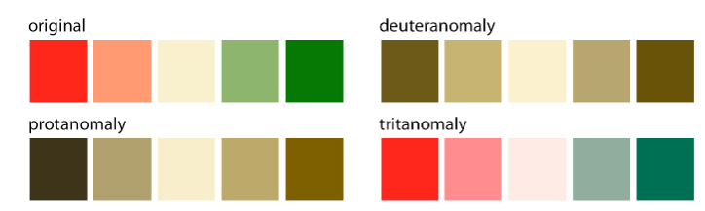
Not designing for color deficiency
Many of our readers may have some form of color-vision deficiency (CVD) – i.e. be “color-blind”
  Protanomoly – difficulty with red
  Deuteranomoly –difficulty with green
  Tritanomly – difficulty with blue
Approx 8% males, 0.5% females
Problematic for red-green CVDs

Slide 36
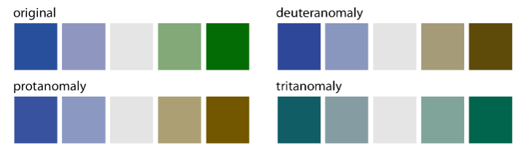
Not designing for color deficiency
Many of our readers may have some form of color-vision deficiency (CVD) – i.e. be “color-blind”
  Protanomoly – difficulty with red
  Deuteranomoly –difficulty with green
  Tritanomly – difficulty with blue
Approx 8% males, 0.5% females
Problematic for blue-yellow CVDs

Slide 37
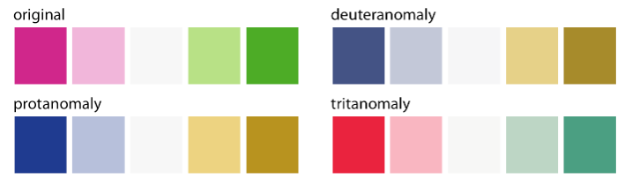
Not designing for color deficiency
The ColorBrewer PiYG (pink to yellow-green) works for all kinds of CVD
The reddish color is actually pink (a mix of red and blue)
The greenish color also contains yellow
Safe for all CVDs

Slide 38
EXTRA STUFF

Slide 39
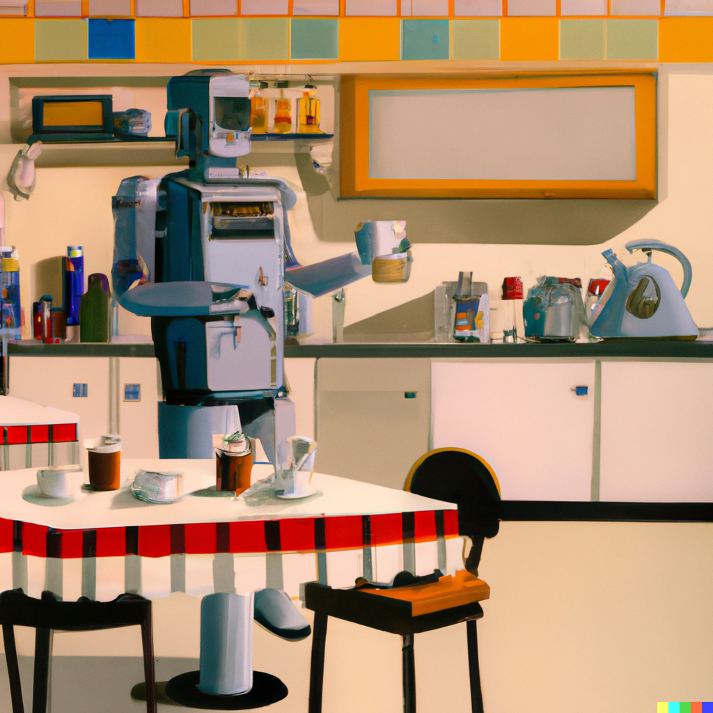
Functions

Slide 40
The robot-in-a-diner analogy
Boil water
Get cup
Put ingredients in cup
Pour water into cup
….
Boil water
Get cup
Put ingredients in cup
Pour water into cup
….
Boil water
Get cup
Put ingredients in cup
Pour water into cup
….
….
….
….

Slide 41
The robot-in-a-diner analogy
The Make Drink function
Boil water
Get cup
Put ingredients in cup
Pour water into cup
Make Drink
Make Drink
Make Drink
…
…
…
…

Slide 42
The robot-in-a-diner analogy
The Make Drink function
Boil water
Get cup
Put ingredients in cup
Pour water into cup
def make_drink():
  boil_water
  get_cup
  put_ingredients_in_cup
  pour_water_into_cup
make_drink()
make_drink()
make_drink()

Slide 43
The robot-in-a-diner analogy
The Make Drink function
Ask customer what drink they want
Boil water
Get cup
Put ingredients in cup
Pour water into cup
def make_drink(name_of_drink):
  boil_water
  get_cup
  if name_of_drink == “coffee”:
    put_coffee_powder_in_cup
  elif name_of_drink == “tea”:
    put_tea_bag_in_cup
  pour_water_into_cup

Slide 44
The robot-in-a-diner analogy
The Make Drink function
Ask customer what drink they want
Boil water
Get cup
Put ingredients in cup
Pour water into cup
Give cup to customer
def make_drink(name_of_drink):
  boil_water
  get_cup
  if name_of_drink == “coffee”:
    put_coffee_powder_in_cup
  elif name_of_drink == “tea”:
    put_tea_bag_in_cup
  pour_water_into_cup
  return cup

Slide 45
The robot-in-a-diner analogy
def make_drink(name_of_drink):
  boil_water
  get_cup
  if name_of_drink == “coffee”:
    put_coffee_powder_in_cup
  elif name_of_drink == “tea”:
    put_tea_bag_in_cup
  pour_water_into_cup
  return cup
jaime_drink = make_drink(“tea”)
eirik_drink = make_drink(“coffee”)

Slide 46
The robot-in-a-diner analogy
def boil_water():
  fill_kettle_with_water
  turn_on_kettle
def make_drink(name_of_drink):
  boil_water()
  get_cup
  if name_of_drink == “coffee”:
    put_coffee_powder_in_cup
  elif name_of_drink == “tea”:
    put_tea_bag_in_cup
  pour_water_into_cup
  return cup

Slide 47
Functions
Allow a set of instructions to be repeated easily.
def name_of_function():
code_to_do_something
def say_hello():
print(“Hello”)
say_hello()

Slide 48
Functions
Allow a set of instructions to be repeated easily.
def name_of_function(positional_arguments):
code_to_do_something_with_positional_args
def say_hello(name):
print(“Hello”, name)
say_hello(“Mo Salah”)

Slide 49
Functions
Allow a set of instructions to be repeated easily.
def name_of_function(positional_arguments):
item = code_to_do_something_with_positional_args
return item
def say_hello(name):
greeting = “Hello ” + name
return greeting
hello_for_kev = say_hello(“Kevin”)
print(hello_for_kev)

Slide 50
Functions
Allow a set of instructions to be repeated easily.
def name_of_function(pos_arguments, optional_args=…):
item = code_to_do_something_with_args
return item
def say_hello(name, language=“English”):
if language == “English”:
greeting = “Hello ” + name
else:
greeting = “God morgen ” + name
return greeting

Slide 51
Functions – doc-strings
Doc-strings provide users (including yourself!) with information about how to use the function
There are different styles of writing them – e.g. Google-style, Numpy-style, and rest-style
Read the associated page(s) in the Good Research Code Handbook.
Good doc-strings make producing documentation for your code a lot simpler.

Slide 52
Functions – doc strings
def say_hello(name):
“””
This is a function for making greetings for different people.
Arguments:
name (str): the name of the person to greet
Returns:
str: the greeting for the named person
“””
greeting = “Hello ” + name
return greeting

